Slide 1
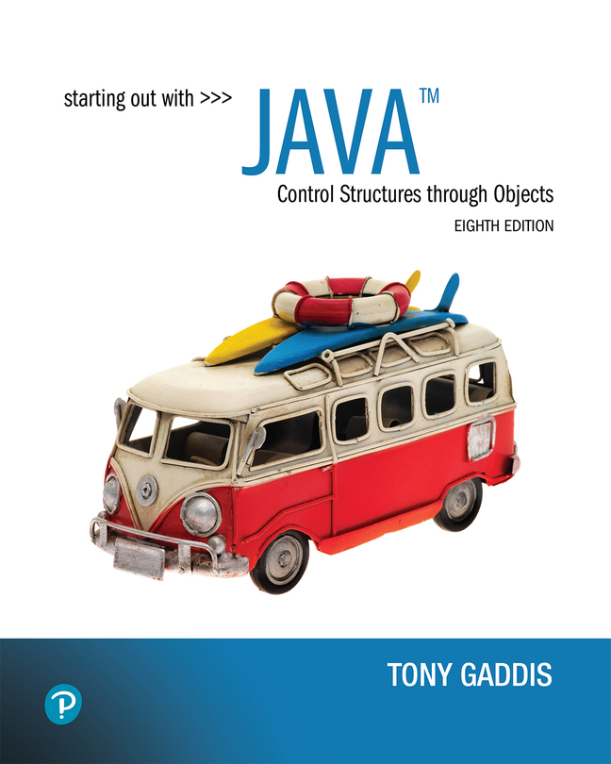

Starting Out with Java Control Structures Through Objects
Eighth Edition
Chapter 4
Loops and Files
Copyright © 2022 Pearson Education, Inc. All Rights Reserved
Notes:
If this PowerPoint presentation contains mathematical equations, you may need to check that your computer has the following installed:
1) MathType Plugin
2) Math Player (free versions available)
3) NVDA Reader (free versions available)

Slide 2
Chapter Topics (1 of 2)
Chapter 4 discusses the following main topics:
The Increment and Decrement Operators
The while Loop
Using the while Loop for Input Validation
The do-while Loop
The for Loop
Running Totals and Sentinel Values

Slide 3
Chapter Topics (2 of 2)
Chapter 4 discusses the following main topics:
Nested Loops
The break and continue Statements
Deciding Which Loop to Use
Introduction to File Input and Output
Generating Random Numbers with the Random class

Slide 4
The Increment and Decrement Operators
There are numerous times where a variable must simply be incremented or decremented.
number = number + 1;
number = number – 1;
Java provide shortened ways to increment and decrement a variable’s value.
Using the ++ or -- unary operators, this task can be completed quickly.
number++; or ++number;
number--; or --number;
Example: IncrementDecrement.java

Slide 5
Differences Between Prefix and Postfix
When an increment or decrement are the only operations in a statement, there is no difference between prefix and postfix notation.
When used in an expression:
prefix notation indicates that the variable will be incremented or decremented prior to the rest of the equation being evaluated.
postfix notation indicates that the variable will be incremented or decremented after the rest of the equation has been evaluated.
Example: Prefix.java

Slide 6
The while Loop (1 of 2)
Java provides three different looping structures.
The while loop has the form:
while(condition)
{
statements;
}
While the condition is true, the statements will execute repeatedly.
The while loop is a pretest loop, which means that it will test the value of the condition prior to executing the loop.

Slide 7
The while Loop (2 of 2)
Care must be taken to set the condition to false somewhere in the loop so the loop will end.
Loops that do not end are called infinite loops.
A while loop executes 0 or more times. If the condition is false, the loop will not execute.
Example: WhileLoop.java

Slide 8
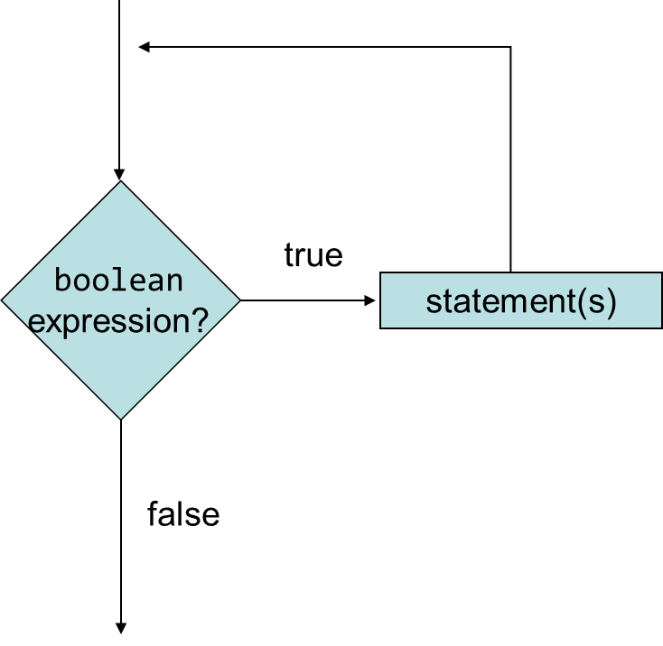
The while Loop Flowchart
Notes:
The process flow involves the verification of the Boolean expression. If the condition is true, the next step includes statements, which again involves the decision making step. If the condition is false, the loop is exited.

Slide 9
Infinite Loops (1 of 2)
In order for a while loop to end, the condition must become false. The following loop will not end:
int x = 20;
while(x > 0)
{
System.out.println("x is greater than 0");
}
The variable x never gets decremented so it will always be greater than 0.
Adding the x-- above fixes the problem.

Slide 10
Infinite Loops (2 of 2)
This version of the loop decrements x during each iteration:
int x = 20;
while(x > 0)
{
System.out.println("x is greater than 0");
x--;
}

Slide 11
Block Statements in Loops
Curly braces are required to enclose block statement while loops. (like block if statements)
while (condition)
{
statement;
statement;
statement;
}

Slide 12
The while Loop for Input Validation
Input validation is the process of ensuring that user input is valid.
System.out.print("Enter a number in the " +
"range of 1 through 100: ");
number = keyboard.nextInt();
// Validate the input.
while (number < 1 || number > 100)
{
System.out.println("That number is invalid.");
System.out.print("Enter a number in the " +
"range of 1 through 100: ");
number = keyboard.nextInt();
}
Example: SoccerTeams.java

Slide 13
The do-while Loop
The do-while loop is a post-test loop, which means it will execute the loop prior to testing the condition.
The do-while loop (sometimes called called a do loop) takes the form:
do
{
statement(s);
} while (condition);
Example: TestAverage1.java

Slide 14
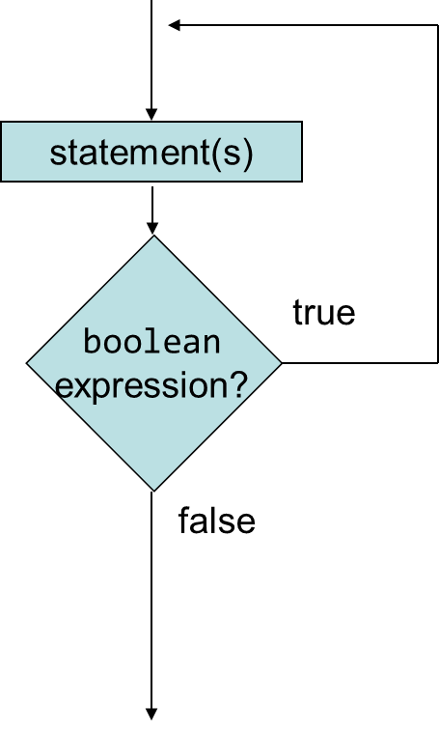
The do-while Loop Flowchart
Notes:
The process flow involves a statement, which then leads to the verification of the Boolean expression. If the condition is true, the next step leads again to the statement. If the condition is false, the loop is exited.

Slide 15
The for Loop
The for loop is a pre-test loop.
The for loop allows the programmer to initialize a control variable, test a condition, and modify the control variable all in one line of code.
The for loop takes the form:
for (initialization; test; update)
{
statement(s);
}
See example: Squares.java

Slide 16
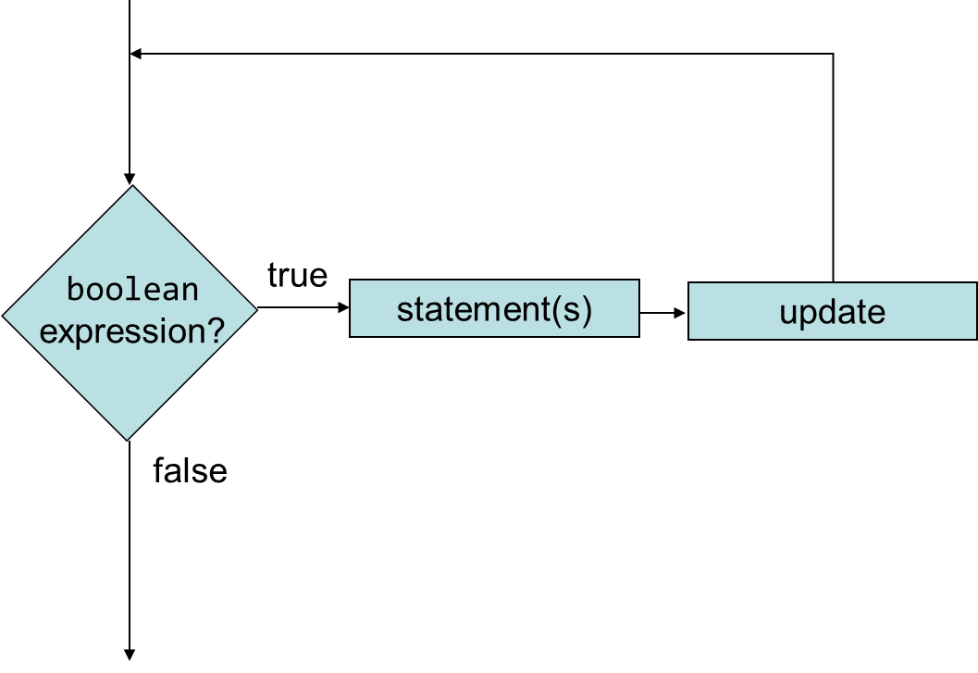
The for Loop Flowchart
Notes:
The process flow involves the verification of the Boolean expression. If the condition is true, the next step includes statements, which leads to an update, which again involves the decision making step. If the condition is false, the loop is exited.

Slide 17
The Sections of the for Loop
The initialization section of the for loop allows the loop to initialize its own control variable.
The test section of the for statement acts in the same manner as the condition section of a while loop.
The update section of the for loop is the last thing to execute at the end of each loop.
Example: UserSquares.java

Slide 18
The for Loop Initialization
The initialization section of a for loop is optional; however, it is usually provided.
Typically, for loops initialize a counter variable that will be tested by the test section of the loop and updated by the update section.
The initialization section can initialize multiple variables.
Variables declared in this section have scope only for the for loop.

Slide 19
The Update Expression
The update expression is usually used to increment or decrement the counter variable(s) declared in the initialization section of the for loop.
The update section of the loop executes last in the loop.
The update section may update multiple variables.
Each variable updated is executed as if it were on a line by itself.

Slide 20
Modifying the Control Variable
You should avoid updating the control variable of a for loop within the body of the loop.
The update section should be used to update the control variable.
Updating the control variable in the for loop body leads to hard to maintain code and difficult debugging.

Slide 21
Multiple Initializations and Updates
The for loop may initialize and update multiple variables.
for (int i = 5, int j = 0; i < 10 || j < 20; i++, j+=2)
{
statement(s);
}
Note that the only parts of a for loop that are mandatory are the semicolons.
for (;;)
{
statement(s);
} // infinite loop
If left out, the test section defaults to true.

Slide 22
Running Totals
Loops allow the program to keep running totals while evaluating data.
Imagine needing to keep a running total of user input.
Example: TotalSales.java

Slide 23
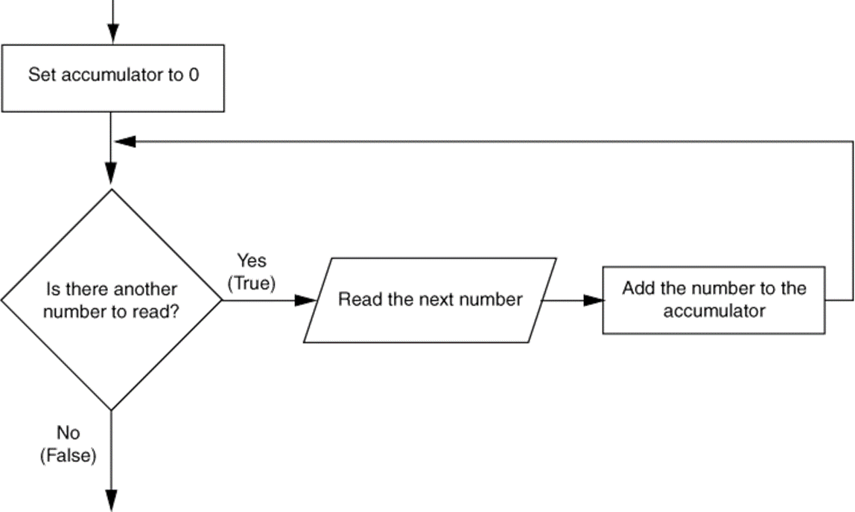
Logic for Calculating a Running Total
Notes:
The process flow is as follows. The accumulator is set to 0. The next step involves the verification of the condition, is there another number to read. If the condition is true, the next step includes the statement, read the next number. This step leads to an update, add the number to the accumulator. This step again involves the decision making step. If the condition is false, the loop is exited.

Slide 24
Sentinel Values
Sometimes the end point of input data is not known.
A sentinel value can be used to notify the program to stop acquiring input.
If it is a user input, the user could be prompted to input
data that is not normally in the input data range
where normal input would be positive.)
Programs that get file input typically use the end-of-file marker to stop acquiring input data.
Example: SoccerPoints.java

Slide 25
Nested Loops
Like if statements, loops can be nested.
If a loop is nested, the inner loop will execute all of its iterations for each time the outer loop executes once.
for (int i = 0; i < 10; i++)
for (int j = 0; j < 10; j++)
loop statements;
The loop statements in this example will execute 100 times.
Example: Clock.java

Slide 26
The break Statement
The break statement can be used to abnormally terminate a loop.
The use of the break statement in loops bypasses the normal mechanisms and makes the code hard to read and maintain.
It is considered bad form to use the break statement in this manner.

Slide 27
The continue Statement
The continue statement will cause the currently executing iteration of a loop to terminate and the next iteration will begin.
The continue statement will cause the evaluation of the condition in while and for loops.
Like the break statement, the continue statement should be avoided because it makes the code hard to read and debug.

Slide 28
Deciding Which Loops to Use
The while loop:
Pretest loop
Use it where you do not want the statements to execute if the condition is false in the beginning.
The do-while loop:
Post-test loop
Use it where you want the statements to execute at least one time.
The for loop:
Pretest loop
Use it where there is some type of counting variable that can be evaluated.

Slide 29
File Input and Output
Reentering data all the time could get tedious for the user.
The data can be saved to a file.
Files can be input files or output files.
Files:
Files have to be opened.
Data is then written to the file.
The file must be closed prior to program termination.
In general, there are two types of files:
binary
text

Slide 30
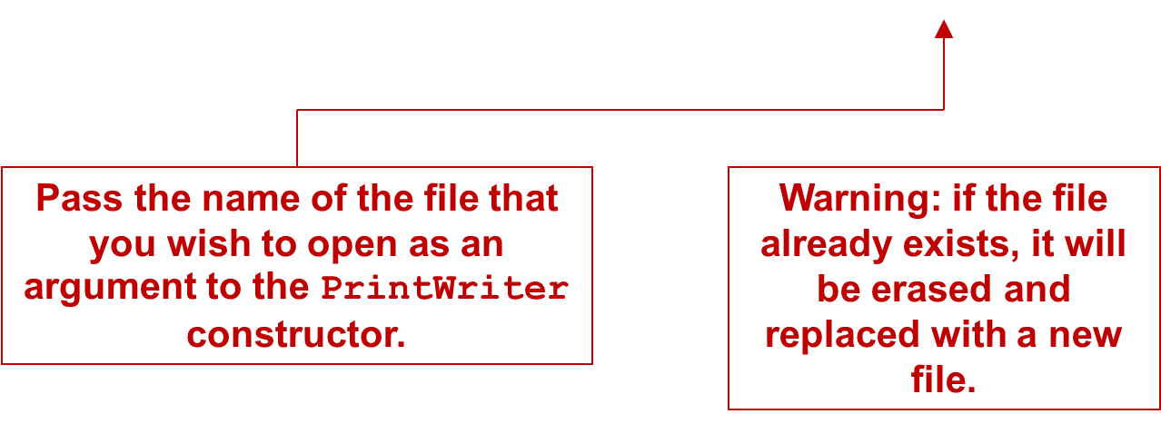
Writing Text to a File
To open a file for text output you create an instance of the PrintWriter class.
PrintWriter outputFile = new PrintWriter("StudentData.txt");

Slide 31
The PrintWriter Class (1 of 3)
The PrintWriter class allows you to write data to a file using the print and println methods, as you have been using to display data on the screen.
Just as with the System.out object, the println method of the PrintWriter class will place a newline character after the written data.
The print method writes data without writing the newline character.

Slide 32
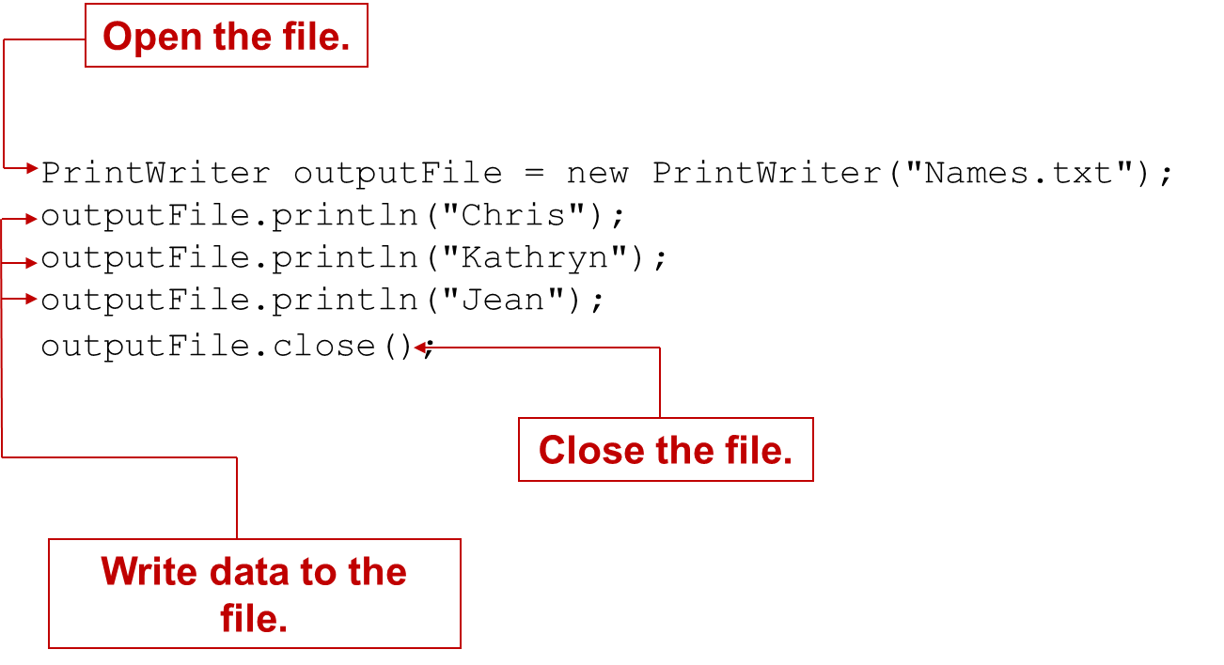
The PrintWriter Class (2 of 3)
Notes:
The program code is as follows. Line 1. Print Writer output file = new Print Writer left parenthesis open quotes Names dot txt close quotes right parenthesis semicolon. Line 1 is labeled, Open the file. Line 2. output file dot Print In left parenthesis open quotes Chris close quotes right parenthesis semicolon. Line 3. output file dot Print In left parenthesis open quotes Kathryn close quotes right parenthesis semicolon. Line 4. output file dot Print In left parenthesis open quotes Jean close quotes right parenthesis semicolon. Lines 2, 3, and 4 are together labeled, Write data to the file. Line 5. output file dot close left parenthesis right parenthesis semicolon. Line 5 is labeled, Close the file.

Slide 33
The PrintWriter Class (3 of 3)
To use the PrintWriter class, put the following import statement at the top of the source file:
import java.io.*;
See example: FileWriteDemo.java

Slide 34
Exceptions (1 of 2)
When something unexpected happens in a Java program, an exception is thrown.
The method that is executing when the exception is thrown must either handle the exception or pass it up the line.
Handling the exception will be discussed later.
To pass it up the line, the method needs a throws clause in the method header.

Slide 35
Exceptions (2 of 2)
To insert a throws clause in a method header, simply add the word throws and the name of the expected exception.
PrintWriter objects can throw an IOException, so we write the throws clause like this:
public static void main(String[] args) throws IOException

Slide 36
Appending Text to a File (1 of 2)
To avoid erasing a file that already exists, create a FileWriter object in this manner:
FileWriter fw = new FileWriter("names.txt", true);
Then, create a PrintWriter object in this manner:
PrintWriter fw = new PrintWriter(fw);

Slide 37
Appending Text to a File (2 of 2)
The two statements can be combined into a single statement:
PrintWriter fw = new PrintWriter( new FileWriter("names.txt", true));

Slide 38
Specifying a File Location (1 of 2)
On a Windows computer, paths contain backslash (\) characters.
Remember, if the backslash is used in a string literal, it is the escape character so you must use two of them:
PrintWriter outFile =
new PrintWriter("D:\\PriceList.txt");

Slide 39
Specifying a File Location (2 of 2)
This is only necessary if the backslash is in a string literal.
If the backslash is in a String object then it will be handled properly.
Fortunately, Java allows Unix style filenames using the forward slash (/) to separate directories:
PrintWriter outFile = new
PrintWriter("/home/rharrison/names.txt");

Slide 40
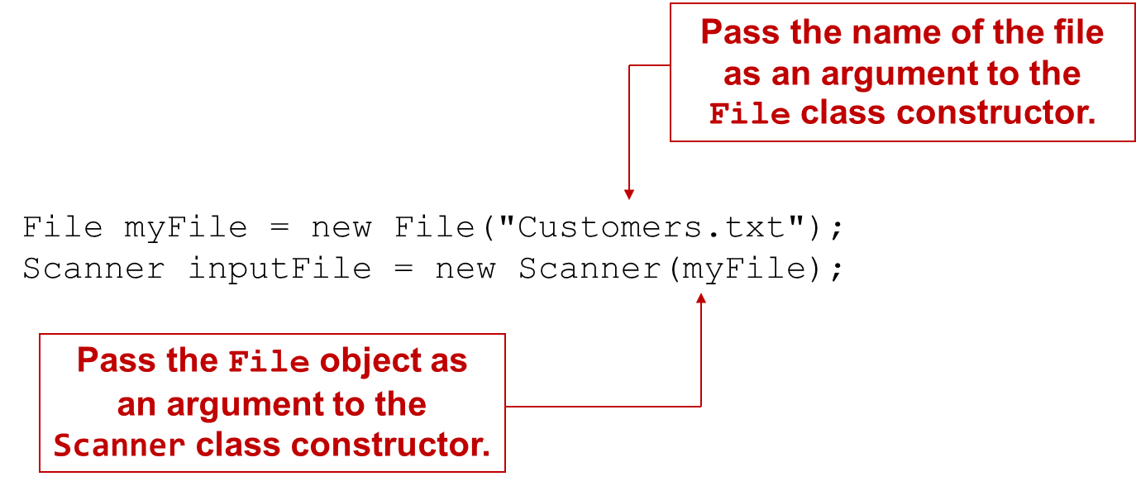
Reading Data From a File (1 of 4)
You use the File class and the Scanner class to read data from a file:
Notes:
The Program code is as follows. Line 1. File my file = new file left parenthesis open quotes Customers dot txt close quotes right parenthesis semicolon. The text within parenthesis in Line 1 is labeled, pass the name of the file as an argument to the File class constructor. Line 2. Scanner input file = new Scanner left parenthesis my File right parenthesis semicolon. The text within parenthesis in Line 2 is labeled, pass the file object as an argument to the Scanner class constructor.

Slide 41
Reading Data From a File (2 of 4)
You can declare the File object and the Scanner object in one statement:
Scanner inputFile = new Scanner(
new File("Customers.txt"));

Slide 42
Reading Data From a File (3 of 4)
Scanner keyboard = new Scanner(System.in);
System.out.print("Enter the filename: ");
String filename = keyboard.nextLine();
Scanner inputFile = new Scanner(new File(filename));
The lines above:
Creates an instance of the Scanner class to read from the keyboard
Prompt the user for a filename
Get the filename from the user
Create an instance of the File class to represent the file
Create an instance of the Scanner class that reads from the file

Slide 43
Reading Data From a File (4 of 4)
Once an instance of Scanner is created, data can be read using the same methods that you have used to read keyboard input (nextLine, nextInt, nextDouble, etc).
// Open the file.
Scanner inputFile = new Scanner(new File("Names.txt"));
// Read a line from the file.
String str = inputFile.nextLine();
// Close the file.
inputFile.close();

Slide 44
Exceptions
The Scanner class can throw an IOException when a File object is passed to its constructor.
So, we put a throws IOException clause in the header of the method that instantiates the Scanner class.
See Example: ReadFirstLine.java

Slide 45
Detecting the End of a File (1 of 2)
The Scanner class’s hasNext() method will return true if another item can be read from the file.
// Open the file.
Scanner inputFile = new Scanner(new File(filename));
// Read until the end of the file.
while (inputFile.hasNext())
{
String str = inputFile.nextLine();
System.out.println(str);
}
inputFile.close();// close the file when done.

Slide 46
Detecting the End of a File (2 of 2)
See example: FileReadDemo.java

Slide 47
Managing Resources With the try-with-resources Statement (1 of 4)
The try-with-resources statement can be used to open a file and automatically close the file.
General format:
try (Declaration statement for file object)
{
// Statements that work with the file…
}

Slide 48
Managing Resources With the try-with-resources Statement (2 of 4)
Example:
try (PrintWriter outputFile = new PrintWriter("myfile.txt"))
{
// Statements that write to the file…
}
This example opens a file named myfile.txt
Code inside the braces can use the PrintWriter object to write data to the file
When the code inside the braces has finished, the file is automatically closed

Slide 49
Managing Resources With the try-with-resources Statement (3 of 4)
Example:
try (Scanner inputFile = new Scanner(new File("myfile.txt")))
{
// Statements that read from the file…
}
This example opens a file named myfile.txt
Code inside the braces can use the Scanner object to read data from the file
When the code inside the braces has finished, the file is automatically closed

Slide 50
Managing Resources With the try-with-resources Statement (4 of 4)
Opening two files with a try-with-resources statement:
try (Scanner inputFile = new Scanner(new File("File1.txt"));
PrintWriter outputFile = new PrintWriter("File2.txt"))
{
// Statements that work with both files…
}
This example opens a file named File1.txt for reading and a file named File2.txt for writing
Code inside the braces can use the Scanner object to read data from File1.txt and the PrintWriter object to write data to File2.txt
When the code inside the braces has finished, both files are automatically closed

Slide 51
Generating Random Numbers with the Random Class
Some applications, such as games and simulations, require the use of randomly generated numbers.
The Java API has a class, Random, for this purpose. To use the Random class, use the following import statement and create an instance of the class.
import java.util.Random;
Random randomNumbers = new Random();

Slide 52
Some Methods of the Random Class
Method | Description
nextDouble() | Returns the next random number as a double. The number will be within the range of 0.0 and 1.0.
nextFloat() | Returns the next random number as a float. The number will be within the range of 0.0 and 1.0.
nextInt() | Returns the next random number as an int. The number will be within the range of an int, which is –2,147,483,648 to +2,147,483,648.
nextInt(int n) | This method accepts an integer argument, n. It returns a random number as an int. The number will be within the range of 0 to n.
See example: RollDice.java

Slide 53

Copyright
This work is protected by United States copyright laws and is provided solely for the use of instructors in teaching their courses and assessing student learning. Dissemination or sale of any part of this work (including on the World Wide Web) will destroy the integrity of the work and is not permitted. The work and materials from it should never be made available to students except by instructors using the accompanying text in their classes. All recipients of this work are expected to abide by these restrictions and to honor the intended pedagogical purposes and the needs of other instructors who rely on these materials.

